Slide 1
BINARY TREE vs. BINARY SEARCH TREE
Presented by : Praveen
Faculty Advisor : Dr. Victor Govindaswamy

Slide 2
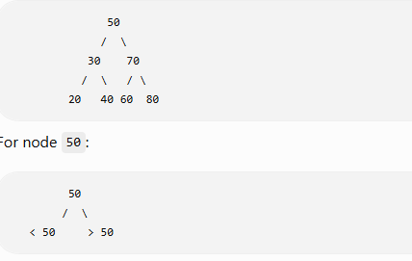
QUEUE DATA STRUCTURE
Binary Tree
A binary tree is a tree data structure where each node can have at most two children.
The children are called:
  Left child
  Right child
There is no requirement that the values be sorted.
Binary Search Tree (BST)
A Binary Search Tree is a binary tree with an ordering rule:
Smaller values → LEFT subtree
Larger values → RIGHT subtree
Values smaller than 50 go to the left.
Values larger than 50 go to the right.
Duplicate values are not inserted for this assignment.
Key Difference
Binary Tree: Structure only.
BST: Structure + ordering rule.

Slide 3
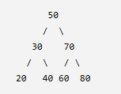
BINARY TREE TERMINOLOGY
Node
Each individual element in the tree.
Example: 50 is a node.
Root
The topmost node.
Root = 50
Parent
A node that has one or more children.
30 is the parent of 20 and 40.
Child
A node directly connected below a parent.
20 and 40 are children of 30.
Left Child
The child connected on the left.
20 is the left child of 30.
Right Child
The child connected on the right.
40 is the right child of 30.
Leaf
A node with no children.
20, 40, 60, and 80 are leaf nodes.

Slide 4
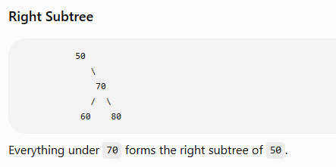
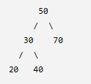
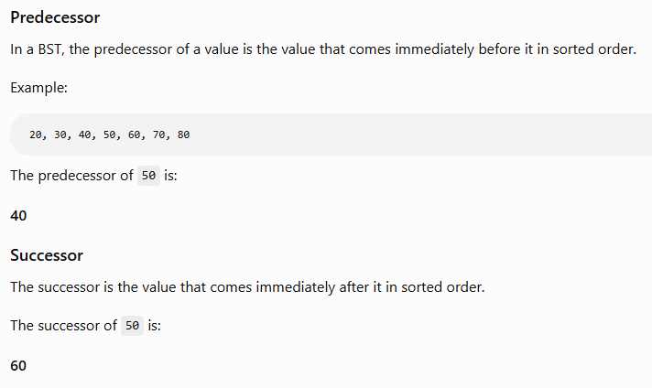
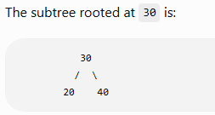
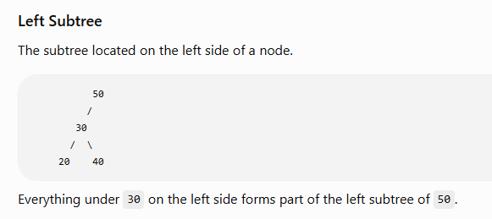
SUBTREE, PREDECESSOR & SUCCESSOR
Subtree
A subtree is a smaller tree that starts from a particular node and includes its descendants.
For example:

Slide 5
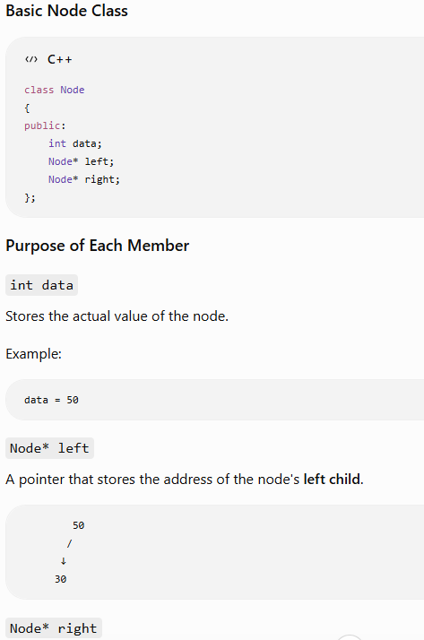
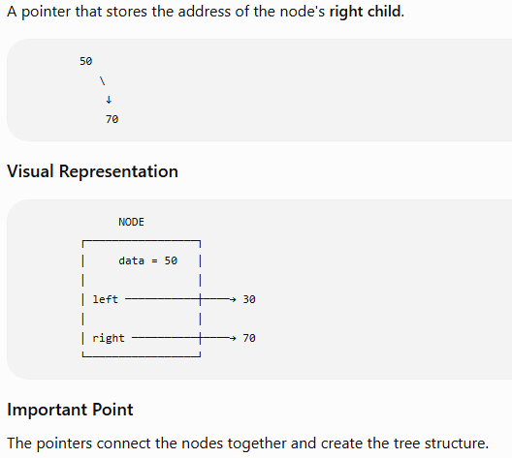
NODE CLASS & POINTERS

Slide 6
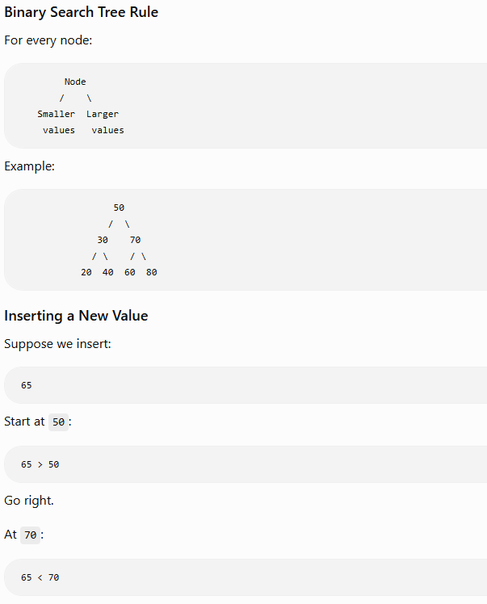
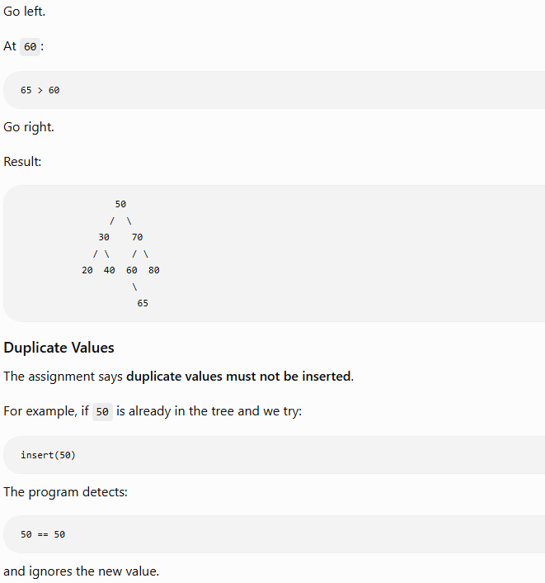
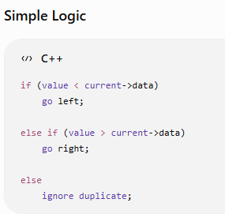
BST INSERTION & DUPLICATES

